Slide 1
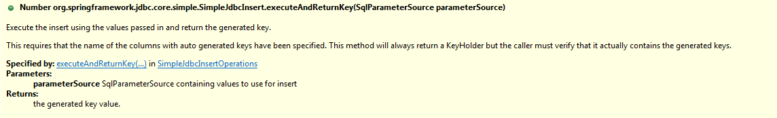
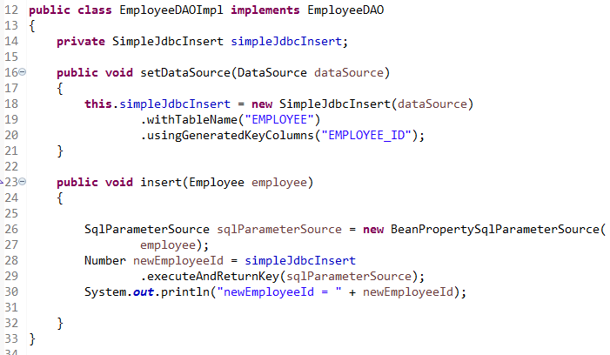
Using SqlParameterSource to provide parameter values
Using a Map to provide parameter values works fine, but it’s not the most convenient class to use. Spring provides a couple of implementations of the SqlParameterSource interface that can be used instead. The first one is BeanPropertySqlParameterSource, which is a very convenient class if you have a JavaBean-compliant class that contains your values. It will use the corresponding getter method to extract the parameter values.

